Slide 1
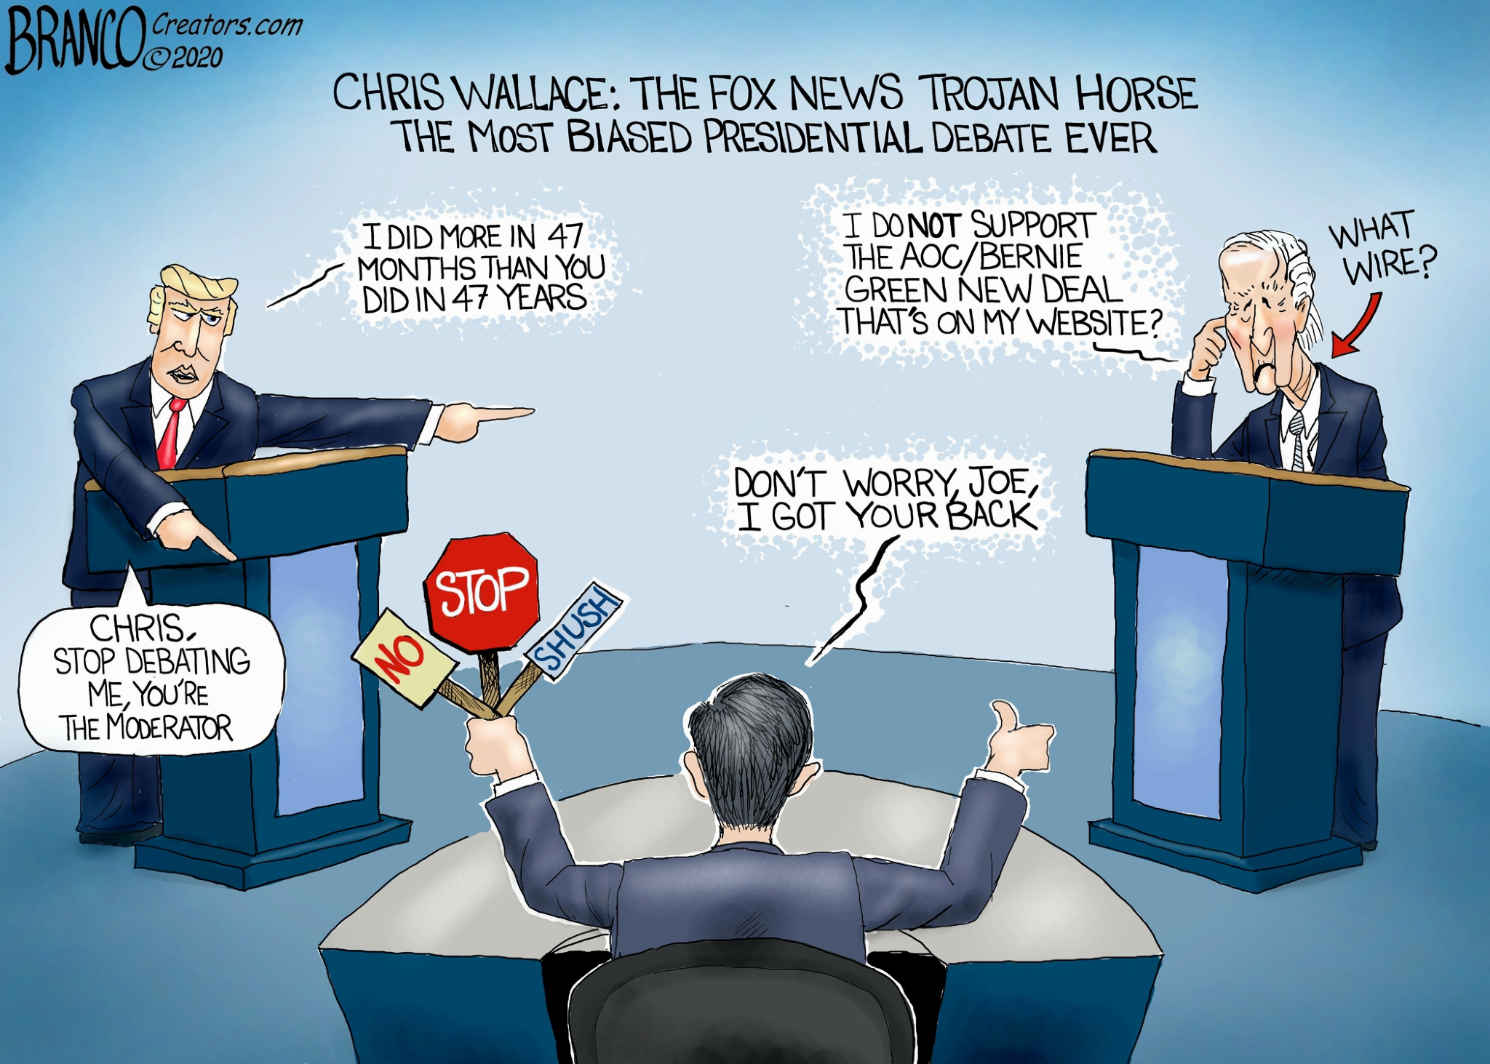
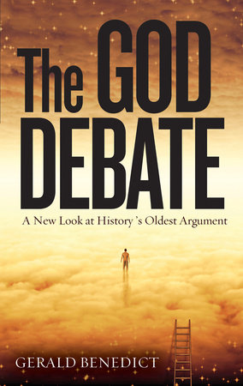

AI-3
Debate God
Prepared By : Happy Whale
Aman Pawar Alvin Vinod Pratik Mukherjee Ojas Kulkarni

Slide 2

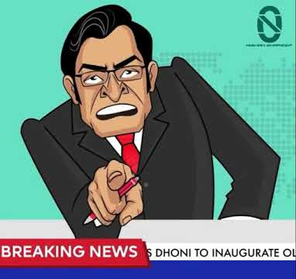
Table of Contents DEBATE GOD
Introduction to Problem Statement
Exploratory Data Analysis
Preprocessing Data
Tokenization of Data
Generating Embeddings
Modelling
Evaluation
Conclusion
Future Scope

Slide 3
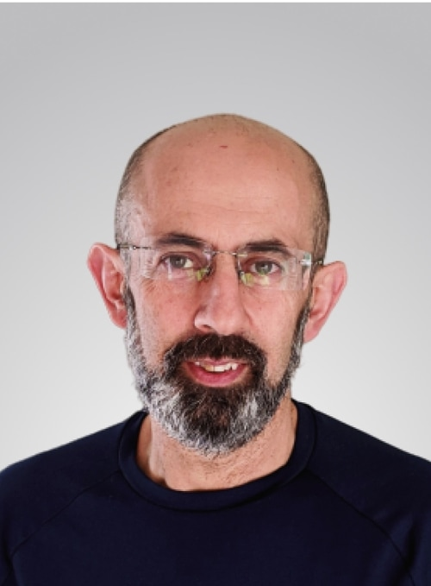


Introduction
Lets imagine a heated debate between the TA’s (Team Pavlos) and Students (Team Happy Whale) over the extension of deadlines, and we obviously need someone to tell who is the winner, hence we have solved the dilemma for you. Debate God is here for you to tell you:
The most effective arguments
The worst arguments
Finally who wins it
Obviously we all know what's the result but lets wait till the end

Slide 4
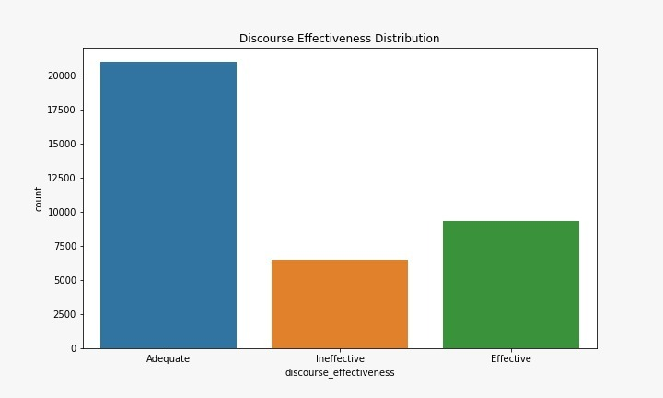
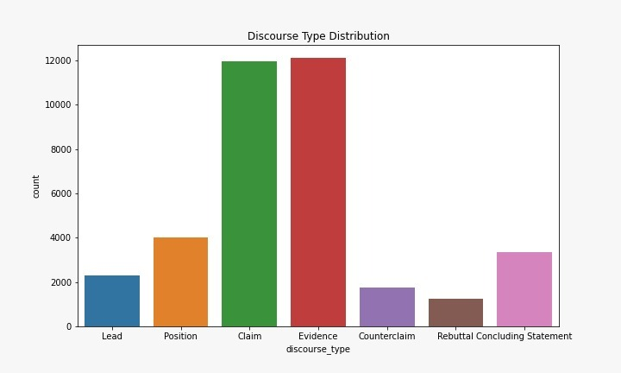
Exploratory Data Analysis

Slide 5
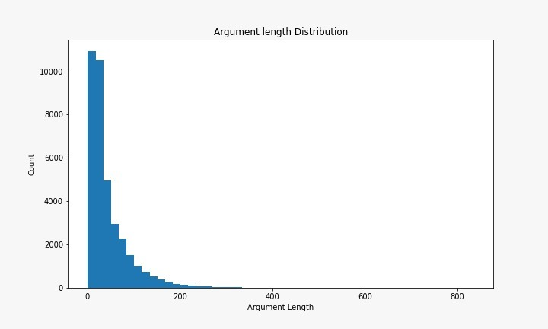
1. Preprocessing Data
1. Remove punctuations
2. Lower Casing
3. Remove stop words
4. Lemmatization
5. Stemming

Slide 6
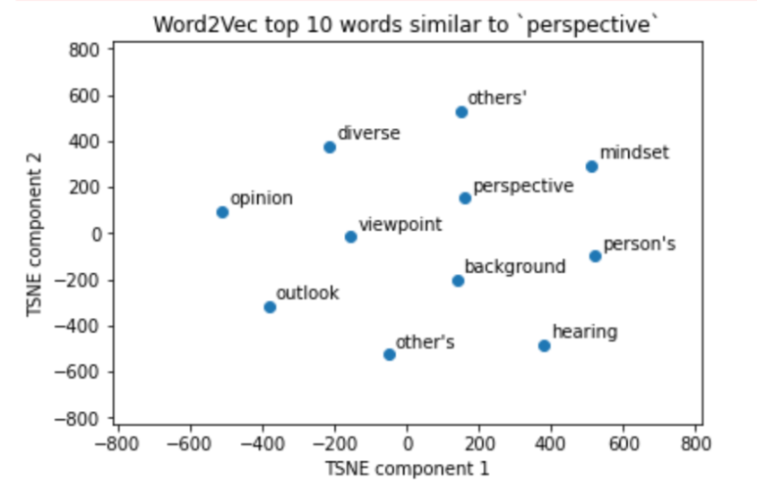
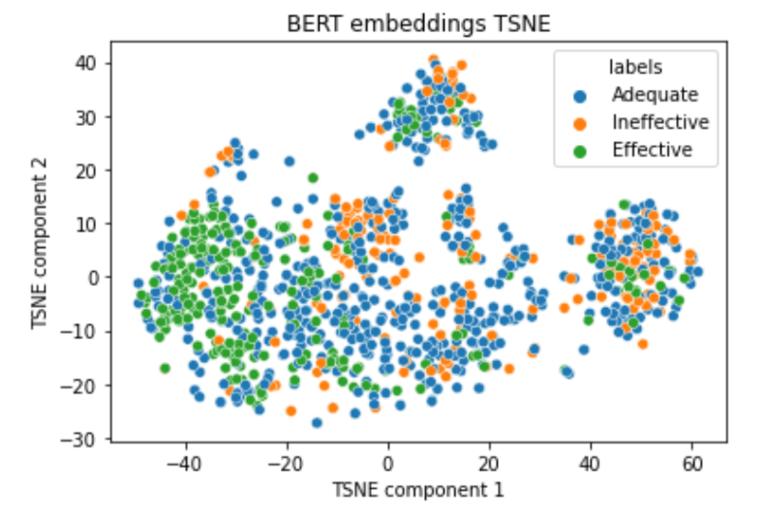
2. Tokenizing data
3. Generating embeddings
1. Whitespace tokenizer
2. Tensorflow tokenizer
1. Word2Vec
2. BERT

Slide 7
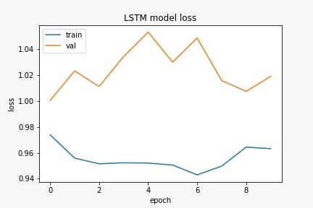
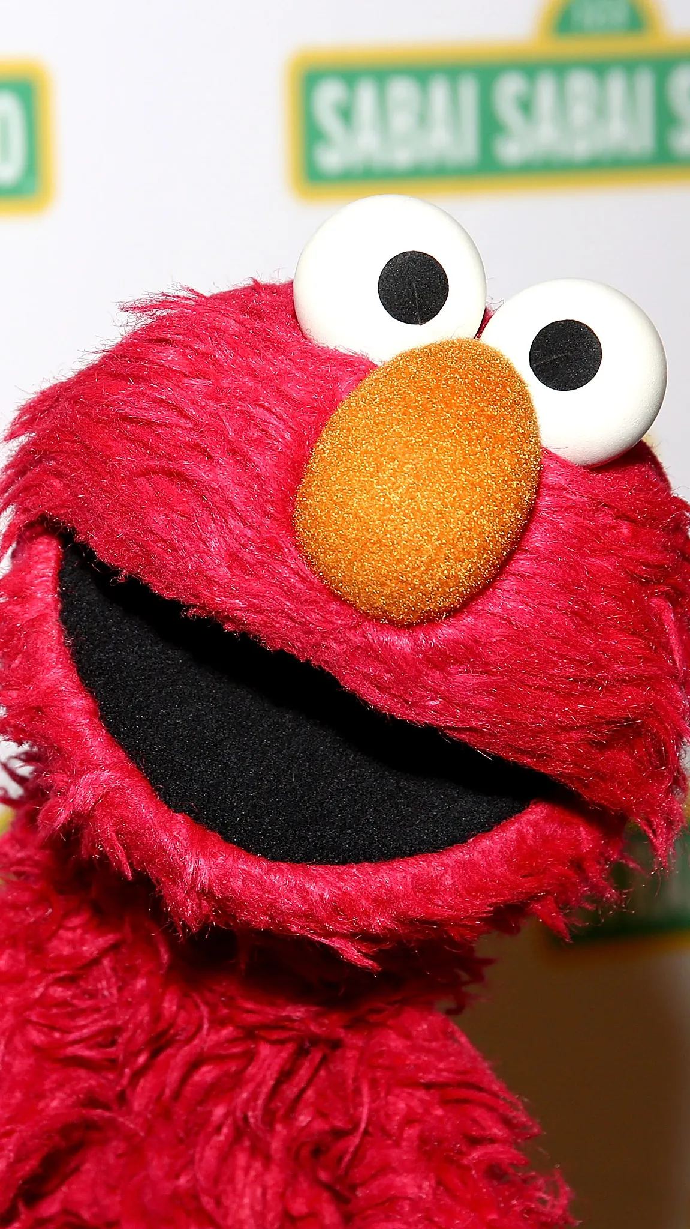
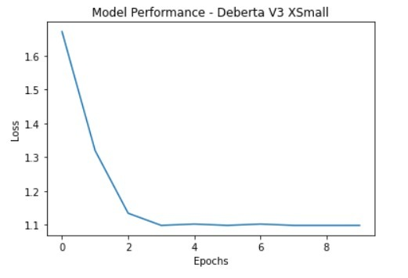
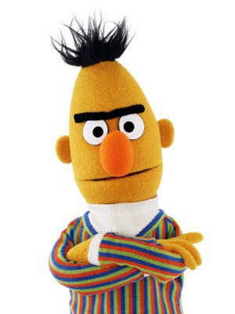
4. Modelling
1. GRU
2. LSTM
3. BERT
4. DeBerta

Slide 8
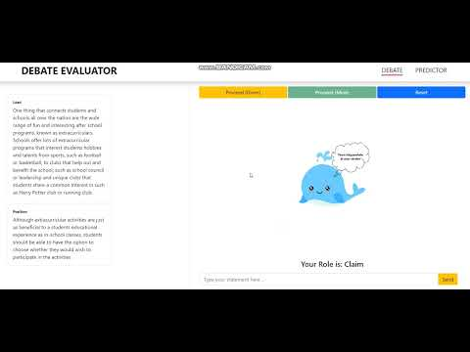
Walkthrough

Slide 9
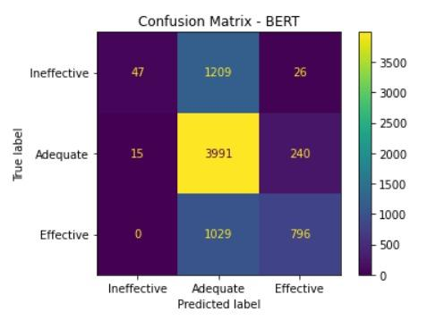
5. Evaluation
1. Accuracy
2. Confusion Matrix
Metrics
Model | GRU | LSTM | Bert | DeBerta
Loss (Sparse Categorical Cross entropy) | 1.02 | 0.96 | 0.85 | 1.09

Slide 10
Conclusion
1. The accuracies are decreasing for DEBERTA model despite the loss converging. However, BERT model is performs better in this aspect with accuracies increasing on training. The final validation losses are comparable for both these models.
2. Data Imbalance is one of the reasons for poor model performance.
Future Scope
Proper handling of imbalance in the data can result in a better scope of results.
The data gathered for the problem statement seemed insufficient for the model to train on.
Ensembling complex NLP models may provide a better result.
Although DeBerta is implemented its performance is quite poor since we have used the extra small version due to shortage of resources to train a larger model. While compared to that BERT has almost 1.5 times more learning parameters.

Slide 11

Thank-You
Team Happy whale is keen to know the feedback
And Debate god is also eager to proclaim it’s superiority in front of zeus and pavlos.

